Slide 1

Department of Artificial Intelligence and Machine Learning
Project Phase I-Title Acceptance and Literature Review
Subject: Project Lab Subject Code: 21AM704
SwarmBee: Swarm Intelligence meets GenAI on Edge
Team Members
1. Chethana R Kini – 4NM21AI018
2. Manya Hegde – 4NM21AI038
3. Reyona Elza Sabu – 4NM21AI059
Guide Name - Dr. Rashmi Adyapady
Designation – Asst. Professor
Department of AIML
NMAMIT-Nitte

Slide 2
Contents
Introduction
Motivation of the project and its scope
Literature Survey
Observations from the survey
References

Slide 3
Introduction
Swarm Intelligence
Gen AI on edge device
Impact and Potential

Slide 4
Motivation and Scope
1. Latency and Bandwidth Limitations in Cloud Computing
2. Resource Constraints for Large Language Models (LLMs) on Edge Devices
3. Inefficiencies in Isolated Edge Devices
4. Challenges in Coordinating Multiple Edge Devices
5. Leveraging AI to Optimize Edge Device Performance

Slide 5
Literature Survey - Paper 1
Paper: Large Language Models as Surrogate Models in Evolutionary Algorithms: A Preliminary Study
Aim of the work | Approaches Utilized | Pros | Cons
Investigate Large Language Models (LLMs) in Evolutionary Algorithms (EAs) as surrogate models. Reduce computational costs by utilizing LLMs' inference capabilities, eliminating training requirements. Demonstrate that LLMs can achieve performance comparable to traditional methods through experiments. | Use LLMs as surrogate models to predict new solution quality in EAs, handling classification or regression tasks. Employ prompt engineering to guide LLMs' inference using task-specific prompts based on historical data. Integrate LLMs into EAs with preprocessing, prompt generation, inference, and post-processing steps to assist in solution selection. | No training required, eliminating computational costs Reduced evaluation costs for expensive optimization problems Effective generalization and comparable performance to traditional models | Limited effectiveness with numerical data Significant inference time overhead Complex prompt engineering and tokenization issues

Slide 6
Literature Survey - Paper 2
Paper: Optimization in Federated Learning
Aim of the work | Approaches Utilized | Pros | Cons
Investigate gradient descent, momentum, and adaptive learning rates in federated learning. Analyze the effects of non-IID and unbalanced data. Identify the best optimization methods for efficient federated learning. | FedSGD: Baseline method, updates global model with aggregated client gradients. Momentum: Standard Momentum and Nesterov’s Accelerated Gradient. Adaptive Learning Rates: AdaGrad, RMSProp, AdaDelta, Adam. | Robustness to Data Distribution Improved Performance Adaptability Efficiency Regularization Effect Hyperparameter Tuning Insights for Practical Applications | Optimization methods struggle with fully non-IID data. AdaGrad underperforms in fully non-IID scenarios. RMSProp and Adam are less effective on fully non-IID data. Requires extensive grid search for optimal configurations. Certain optimizers may not significantly enhance the global model but are beneficial for local models.

Slide 7
Literature Survey - Paper 3
Paper: A survey of federated learning for edge computing: Research problems and​ solutions
Aim of the work | Approaches Utilized | Pros | Cons
Federated Learning for edge computing environments​ API support ​Communication and Computational efficiency​ | Tools that help in managing resources and easily migrate parameter data​ IDEs that include debugging tools and libraries​ Gradient Quantization and Network Pruning | ​ Improved efficiency and reliability​​ User friendly interfaces that result in faster prototyping​ Reduced communication time and faster training time | Integration of these tools is complex and increase overhead​ ​Compatibility issues and resource constraints​ ​Heterogeneity of devices and reduced accuracy of models

Slide 8
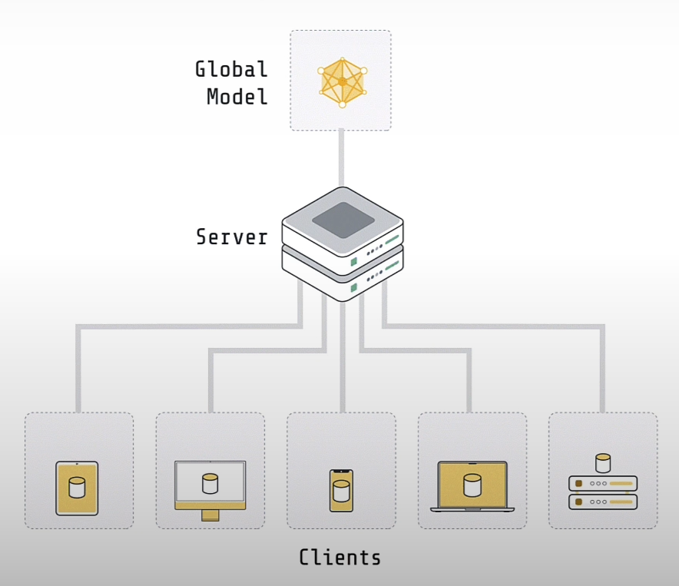
Observations
GEN AI
OUTPUT

Slide 9
References
[1] Hao, H., Zhang, X., & Zhou, A. “Large Language Models as Surrogate Models in Evolutionary Algorithms: A Preliminary Study”. Shanghai Jiao Tong University; East China Normal University.
[2] V. Felbab, P. Kiss, and T. Horváth, "Optimization in Federated Learning," Department of Data Science and Engineering, ELTE – Eötvös Loránd University.
[3] Qi Xia, Winson Ye, Zeyi Tao, Jindi Wu, Qun Li, "A survey of federated learning for edge computing: Research problems and solutions". Department of Computer Science, College of William and Mary USA

